Slide 1
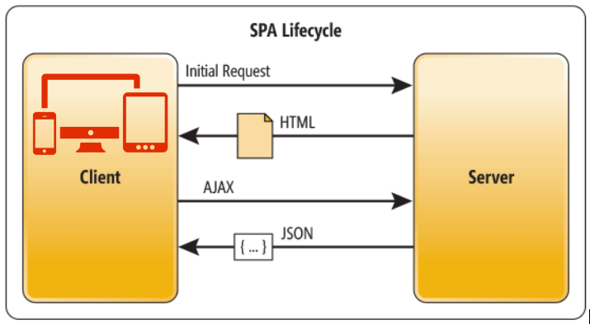
SPA(Single Page Application)

Slide 2
A single-page application (SPA) is a web application or web site that fits on a single web page with the goal of providing a more fluent user experience similar to a desktop application. In a SPA, either all necessary code – HTML, JavaScript, and CSS – is retrieved with a single page load, or the appropriate resources are dynamically loaded and added to the page as necessary, usually in response to user actions.
Or, Single-Page Applications (SPAs) are Web apps that load a single HTML page and dynamically update that page as the user interacts with the app.
Single page apps are distinguished by their ability to redraw any part of the UI without requiring a server roundtrip to retrieve HTML. This is achieved by separating the data from the presentation of data by having a model layer that handles data and a view layer that reads from the models.
In an SPA, after the first page loads, all interaction with the server happens through AJAX calls. These AJAX calls return data usually in JSON format. The app uses the JSON data to update the page dynamically, without reloading the page.
A single-page application (SPA) is a web application or web site that fits on a single web page with the goal of providing a more fluent user experience similar to a desktop application. In a SPA, either all necessary code – HTML, JavaScript, and CSS – is retrieved with a single page load, or the appropriate resources are dynamically loaded and added to the page as necessary, usually in response to user actions.
Or, Single-Page Applications (SPAs) are Web apps that load a single HTML page and dynamically update that page as the user interacts with the app.
Single page apps are distinguished by their ability to redraw any part of the UI without requiring a server roundtrip to retrieve HTML. This is achieved by separating the data from the presentation of data by having a model layer that handles data and a view layer that reads from the models.
In an SPA, after the first page loads, all interaction with the server happens through AJAX calls. These AJAX calls return data usually in JSON format. The app uses the JSON data to update the page dynamically, without reloading the page.
A single-page application (SPA) is a web application or web site that fits on a single web page with the goal of providing a more fluent user experience similar to a desktop application. In a SPA, either all necessary code – HTML, JavaScript, and CSS – is retrieved with a single page load, or the appropriate resources are dynamically loaded and added to the page as necessary, usually in response to user actions.
Or, Single-Page Applications (SPAs) are Web apps that load a single HTML page and dynamically update that page as the user interacts with the app.
Single page apps are distinguished by their ability to redraw any part of the UI without requiring a server roundtrip to retrieve HTML. This is achieved by separating the data from the presentation of data by having a model layer that handles data and a view layer that reads from the models.
In an SPA, after the first page loads, all interaction with the server happens through AJAX calls. These AJAX calls return data usually in JSON format. The app uses the JSON data to update the page dynamically, without reloading the page.
A single-page application (SPA) is a web application or web site that fits on a single web page with the goal of providing a more fluent user experience similar to a desktop application. In a SPA, either all necessary code – HTML, JavaScript, and CSS – is retrieved with a single page load, or the appropriate resources are dynamically loaded and added to the page as necessary, usually in response to user actions.
Or, Single-Page Applications (SPAs) are Web apps that load a single HTML page and dynamically update that page as the user interacts with the app.
Single page apps are distinguished by their ability to redraw any part of the UI without requiring a server roundtrip to retrieve HTML. This is achieved by separating the data from the presentation of data by having a model layer that handles data and a view layer that reads from the models.
In an SPA, after the first page loads, all interaction with the server happens through AJAX calls. These AJAX calls return data usually in JSON format. The app uses the JSON data to update the page dynamically, without reloading the page.
A single-page application (SPA) is a web application or web site that fits on a single web page with the goal of providing a more fluent user experience similar to a desktop application. In a SPA, either all necessary code – HTML, JavaScript, and CSS – is retrieved with a single page load, or the appropriate resources are dynamically loaded and added to the page as necessary, usually in response to user actions.
Or, Single-Page Applications (SPAs) are Web apps that load a single HTML page and dynamically update that page as the user interacts with the app.
Single page apps are distinguished by their ability to redraw any part of the UI without requiring a server roundtrip to retrieve HTML. This is achieved by separating the data from the presentation of data by having a model layer that handles data and a view layer that reads from the models.
In an SPA, after the first page loads, all interaction with the server happens through AJAX calls. These AJAX calls return data usually in JSON format. The app uses the JSON data to update the page dynamically, without reloading the page.
APPLICATION of SPA :-
APPLICATION OF SPA:-
A single-page application (SPA) is a web application or web site that fits on a single web page with the goal of providing a more fluent user experience similar to a desktop application. In a SPA, either all necessary code – HTML, JavaScript, and CSS – is retrieved with a single page load, or the appropriate resources are dynamically loaded and added to the page as necessary, usually in response to user actions.
Or, Single-Page Applications (SPAs) are Web apps that load a single HTML page and dynamically update that page as the user interacts with the app.
Single page apps are distinguished by their ability to redraw any part of the UI without requiring a server roundtrip to retrieve HTML. This is achieved by separating the data from the presentation of data by having a model layer that handles data and a view layer that reads from the models.
In an SPA, after the first page loads, all interaction with the server happens through AJAX calls. These AJAX calls return data usually in JSON format. The app uses the JSON data to update the page dynamically, without reloading the page.

Slide 3
APPLICATION of SPA :-
Comparatively Smoother & Faster
In the case of single page applications, only the required part of content gets updated rather than updating the entire page. This improves the speed of the website significantly.
Throughout the lifespan of the application, most of the resources like HTML or scripts or CSS are loaded only once. It is only data which gets moved here and there.
Now, this can be considered as a huge benefit if the web page takes more than 200 milliseconds to load as this means that it can affect the business and its sales greatly.
Offline Support & Caching
It is possible for a single page application to cache and use local data in an effective manner. A SPA stores all the data that it gets after it sends a single request to a server.
It can even work offline by using data. It is possible for the server to get synchronized with local data when a strong connection is available in case the user currently has poor connectivity.

Slide 4
Linear User Experience
Users get to enjoy a simple linear experience through SPAs. Just like the web apps, these applications also come with a transparent beginning, middle layer and end.
Some of the web apps like Slack, Trello and Spotify offer an excellent interactive experience to the user by making use of amazing transitions and parallax scrolling and effects to depict the customer journey completely.
With SPAs, you don’t have to click on endless links and here scrolling is uninterrupted and convenient. The SPAs come with scroll and this makes them the right choice for the mobile app users who are used to working with scrolling on their apps.
Easy to Debug Using popular browser like Chrome and Firefox.
Compared to MPAs, here the debugging takes place much easier as single page applications come with their own Chrome developer tools.
By using SPAs, you get to investigate the page elements, monitor the network operations and check the data which are associated with the pages.
Even though single page applications come with a number of benefits, there are certain drawbacks attached with it too.

